Slide 1
SINHGAD ACADEMY OF ENGINEERING
Fake Instagram Profile Identification and Classification Using machine Learning
Group No : 40
Under Guidance of
Prof. R.S.Meshram
2023-2024

Slide 2
Contents
Introduction
Motivation
Problem Definition
Literature Survey
Software Requirements Specification
Hardware Requirements Specification
Project Scope
Project Timeline chart.
Assumptions and Dependencies
Architecture
Mathematical model
Algorithms
Data Flow Diagram Level-0
DFD Level-1
DFD Level-2
UML Diagrams
Survey Paper
Detection of Lane and Speed Breaker Warning System for Autonomous Vehicles using Machine Learning Algorithm

Slide 3
Introduction
In recent years, social media platforms like Instagram have gained immense popularity, becoming integral parts of our daily lives.
With the increasing user base, these platforms have also become hotbeds for various forms of online fraud and deception.
One of the prevalent issues on Instagram is the creation and proliferation of fake profiles, which can be used for malicious purposes such as identity theft, spreading misinformation, or conducting scams.
The ability to identify and classify these fake profiles is crucial for maintaining the integrity and security of the platform.
Machine Learning (ML) and Artificial Intelligence (AI) techniques have shown great promise in addressing this issue by automating the process of fake profile detection and classification.
This research aims to develop an effective ML-based solution for identifying and categorizing fake Instagram profiles.

Slide 4
Motivation
The growing need to protect Instagram users from various forms of online deception. Fake profiles can deceive individuals, compromise their personal information, and even manipulate public opinion. Detecting these profiles manually is a daunting task due to the sheer volume of users on the platform. Therefore, an automated approach using machine learning algorithms is not only efficient but also scalable.

Slide 5
Problem Definition
To design a robust system that can automatically identify and categorize these
fake profiles, thereby enhancing the security and trustworthiness of the Instagram
platform.

Slide 6
Literature Survey
Sr. No. | Topic Name | Year | Author Name | Advantages | Disadvantages | Description
1 | Understanding the Digital Lives of Youth: Analyzing Media Shared within Safe Versus Unsafe Private Conversations on Instagram | 2023 | Shiza Ali, Afsaneh Razi | Researchers and policymakers can use this information to develop targeted interventions | Findings from this type of analysis may not be representative of all youth on Instagram. | We performed a mixed-method analysis of the media files shared privately in these conversations to gain human-centered insights into the risky interactions experienced by youth.
2 | Instagram Data Donation: A Case Study on Collecting Ecologically Valid Social Media Data for the Purpose of Adolescent Online Risk Detection | 2022 | Afsaneh Razi, Ashwaq AlSoubai | Over time, this data can be used to track changes in online behaviors, helping to identify trends. | The evolving landscape of social media platform policies and regulations, which may limit data access and usage. | The study aims to create a comprehensive understanding of the online behaviors, interactions, and content consumption patterns of adolescents on the platform.

Slide 7
Literature Survey
Sr. No. | Topic Name | Year | Author Name | Advantages | Disdvantages | Description
3 | Sliding into My DMs: Detecting Uncomfortable or Unsafe Sexual Risk Experiences within Instagram Direct Messages Grounded in the Perspective of Youth | 2023 | AFSANEH RAZI, ASHWAQ ALSOUBAI | Platforms like Instagram, understanding how youth engage in conversations . | Research involving the analysis of private messages on a social media platform may raise ethical concerns related to privacy, consent. | Risk detection and adolescent online safety literature through our human-centered approach of collecting and ground truth coding private social media conversations of youth for the purpose of risk classification.
4 | Happiness and Sadness in Adolescents’ Instagram Direct Messaging: A Neural Topic Modelling Approach | 2022 | Tim Verbeij* , Ine Beyens, Damian Trilling | Neural topic modeling can process large volumes of text data quickly and efficiently. | Analyzing private messages on social media platforms raises ethical concerns regarding privacy and consent. | There are temporal trends in the expression of happiness and sadness in adolescents’ DMs and there are individual differences in these trends.

Slide 8
Literature Survey
Sr. No | Topic Name | Year | Author Name | Advantages | Disadvantages | Description
5 | Object and Text Recognition in Images Shared in Private Instagram Conversations to Detect Risky Content | 2021 | Tess Conroy, Shiza Ali, Dr. Gianluca Stringhini | Identifying and flagging potentially harmful or inappropriate content in private conversations, | Developing and maintaining a robust object and text recognition system requires significant resources, including computational power | To emphasize the importance of ethical considerations, privacy, and consent when implementing such a system.
6 | Unveiling the Emotional and Psychological States of Instagram Users: A Deep Learning Approach to Mental Health Analysis | 2022 | Muhammad K. Alabdly | Provide an objective assessment of emotional and psychological states by analyzing user-generated content. | People may post content that doesn't reflect their actual feelings or may intentionally mislead for various reasons. | Utilizing social network data to diagnose depression has gained extensive acceptance, there is still a number of unidentified characteristics
7 | Fake Instagram Profile Identification and Classification using Machine Learning | 2021 | Preethi Harris , Gojal J | Handle a massive number of profiles, which is crucial on a platform as large as Instagram. | It may lead to unfair or inaccurate profiling and potential discrimination. | The popularity of social media users is determined by followers and hence users resort to different wrong means to promote increased profile.

Slide 9
Software & Hardware Requirements
Software Requirements Specification
Coding Language : Python
Operating System : Windows 10
Hardware Requirements Specification
Processor : Pentium-IV
RAM :512 MB(min)
Hard Disk : 40 GB
Key Board : Standard Windows Keyboard
Mouse : Two or Three Button Mouse
Monitor : LCD/LED

Slide 10
Project Scope
Gathering a diverse dataset of Instagram profiles, including both genuine and fake accounts, and preprocessing the data to make it suitable for machine learning.
Extracting features from Instagram profiles and activities, such as posting behavior, follower statistics, engagement patterns, and content analysis.
Exploring various machine learning algorithms, training the model on the dataset, and optimizing it for accuracy and efficiency.
Developing a classification system to categorize detected fake profiles into specific categories based on their deceptive behavior.
Implementing a solution that can handle both real-time and batch processing of profiles, depending on the deployment scenario.
Ensuring the project adheres to privacy regulations and guidelines, protecting the personal information of users during data collection and processing.

Slide 11
Project Timeline chart
Sr .No | Task | Description | Duration (Months)
1 | Domain selection | Deciding the domain as ML | July
2 | Searching key items | Searching the key items related domain | August
3 | Deciding the topic for project | Fake Instagram Profile Identification and Classification | August
4 | Literature survey | Studied papers related to traffic management
5 | Problem statement | Making the problem statement
6 | Synopsis formation and PPT | Forming synopsis and PPT
7 | Studied existing system | Methodologies and working of the existing system
8 | Mathematical modelling | Forming of mathematical model
9 | Proposed system | Forming the propose of system
10 | Existing system | Forming of existing model
11 | testing
12 | Data analysis
13 | Conclusion and future work
14 | Report generation

Slide 12
Assumptions and Dependencies
Assumptions :
The collected data is of reasonable quality and does not contain significant noise or biases that could adversely affect the model's performance.
The selected features for profile analysis are assumed to be relevant for fake profile detection and classification.
Dependencies :
The project depends on the availability of a suitable dataset of Instagram profiles.
The project depends on successfully training machine learning models using the collected data.
Any changes in data privacy regulations or Instagram's policies may impact the project's execution and deployment.

Slide 13
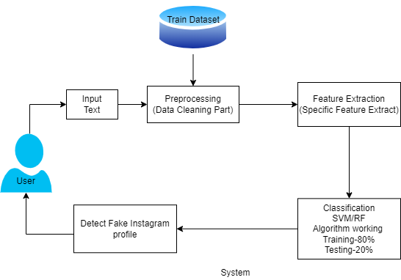
Architecture of Project
Fig : - System architecture

Slide 14
Mathematical Model
Let S be the Whole system S= I,P,O
I-input
P-procedure
O-output
Input( I)
I=Text
Where,
Dataset- Image dataset Using SVM/RF Algorithm
Procedure (P),
P=I, Using I System Detect Fake Instagram profile

Slide 15
Algorithm
Random Forest:
RF is an ensemble learning method that combines multiple decision trees to make predictions.
RF can capture these non-linear relationships effectively.
RF tends to produce stable and consistent results across different runs and datasets, which is important in healthcare where reproducibility is critical.
Step 1: Importing and processing the data.
Step 2: Training the random forest classifier.
Step 3: Testing the prediction accuracy.
Step 4: Visualizing the results of the classifier.

Slide 16
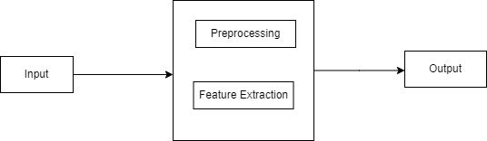
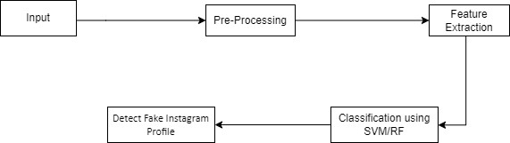
DFD Level Diagram
DFD0
DFD1
DFD2

Slide 17
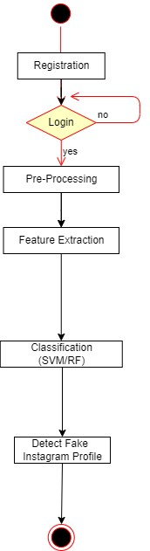
UML Diagrams
Activity Diagram :

Slide 18
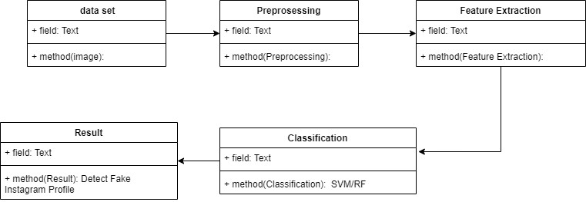
UML Diagrams
Class Diagram :

Slide 19
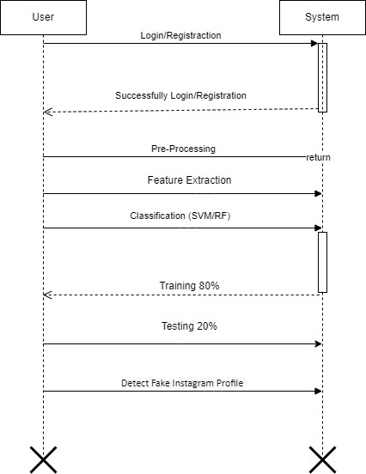
UML Diagrams
Sequence Diagram :

Slide 20
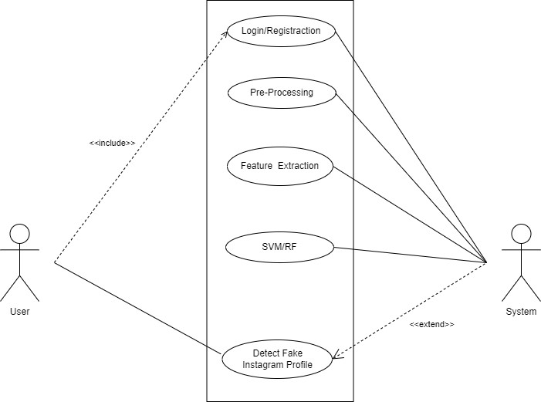
UML Diagrams
Usecase Diagram :

Slide 21
Survey Paper
Zainab Agha, Neeraj Chatlani, Afsaneh Razi, and Pamela Wisniewski. 2020. Towards conducting responsible research with teens and parents regarding online risks. In Extended Abstracts of the 2020 CHI Conference on Human Factors in Computing Systems. 1–8.
Shiza Ali, Afsaneh Razi, Seunghyun Kim, Ashwaq Alsoubai, Joshua Gracie, Munmun De Choudhury, Pamela J Wisniewski, and Gianluca Stringhini. 2022. Understanding the Digital Lives of Youth: Analyzing Media Shared within Safe Versus Unsafe Private Conversations on Instagram. (2022), 1–14.
Detect fake profiles on social media network https://telanganatoday.com/detect-fake-profiles-on-social-medianetworks
Kietzmann, J.H., Hermkens, K., McCarthy, I.P., Silvestre,B.S., 2011. Social media? Get serious! Understanding the functional building blocks of social media. Bus.Horiz., SPECIAL ISSUE: SOCIAL MEDIA 54, 241251. doi:10.1016/j.bushor.2011.01.005.
Aleksei Romanov, Alexander Semenov, Oleksiy Mazhelis and Jari Veijalainen.2017. "Detection of Fake Profiles in Social Media”. In 13th International Conference on Web Information Systems and Technologies. International Journal of Computer Science & Information Technology (IJCSIT) Vol 11, No 5, October 2019

Slide 22
THANK YOU

